Slide 1
Compiler Design
Unit-1 : Introduction
Lecture by Manojeet Roy

Slide 2
Book:- Compilers: Pearson New International Edition

Slide 3
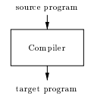

Compiler-Introduction

Slide 4

An interpreter is another common kind of language processor. Instead of producing a target program as a translation, an interpreter appears to directly execute the operations in the source program on inputs supplied by the user, as shown

Slide 5
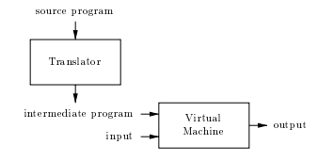
A hybrid compiler

Slide 6
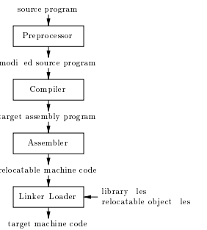

Slide 7
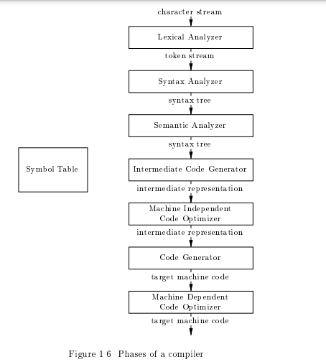
Phases and Passes

Slide 8
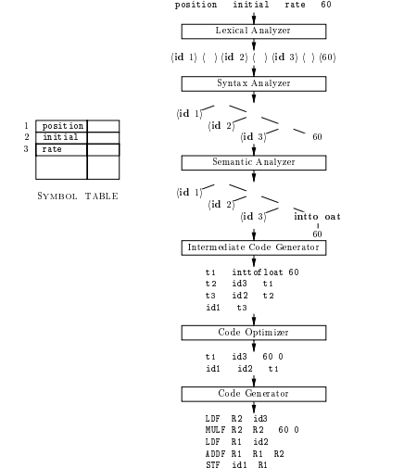
Translation of an assignment statement

Slide 9
Passes in Compiler:
A pass is a component where parts of one or more phases of the compiler are combined when a compiler is implemented. A pass reads or scans the instructions of the source program or the output produced by the previous pass, which makes necessary transformation specified by its phases.
There are generally two types of passes
One-pass
Two-pass

Slide 10
Cont..
One-Pass – In One-pass all the phases are grouped into one phase. The six phases are included here in one pass.
Two-Pass – In Two-pass the phases are divided into two parts i.e. Analysis or Front End part of the compiler and the synthesis part or back end part of the compiler.

Slide 11
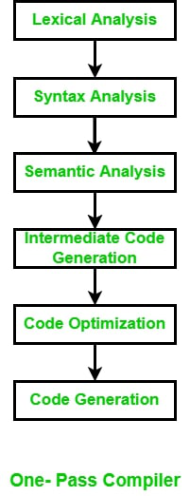
One-Pass

Slide 12
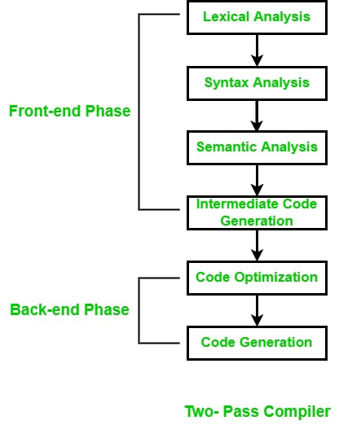
Two-Pass

Slide 13
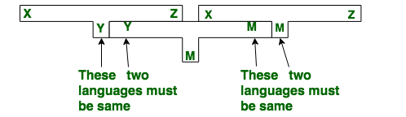
Bootstrapping

Slide 14
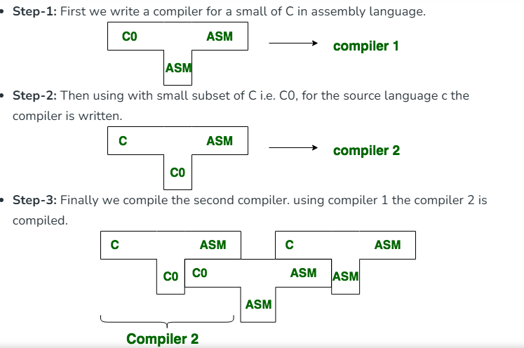
Cont..

Slide 15
Cont..
Step-4: Thus we get a compiler written in ASM which compiles C and generates code in ASM.

Slide 16
Advantages:
Bootstrapping ensures that the compiler is compatible with the language it is designed to compile, as it is written in the same language.
It allows for greater control over the optimization and code generation process.
It provides a high level of confidence in the correctness of the compiler because it is self-hosted.

Slide 17
Disadvantages:
It can be a time-consuming process, especially for complex languages or compilers.
Debugging a bootstrapped compiler can be challenging since any errors or bugs in the compiler will affect the subsequent versions of the compiler.
Bootstrapping requires that a minimal version of the compiler be written in a different language, which can introduce compatibility issues between the two languages.
Overall, bootstrapping is a useful technique in compiler design, but it requires careful planning and execution to ensure that the benefits outweigh the drawbacks.

Slide 18
Finite State Machines and Regular Expressions

Slide 19
Finite State Machines and Regular Expressions and their Applications to Lexical Analysis,
Lexical Analysis is the first phase of a compiler that takes the input as a source code written in a high-level language.
The purpose of lexical analysis is that it aims to read the input code and break it down into meaningful elements called tokens.

Slide 20
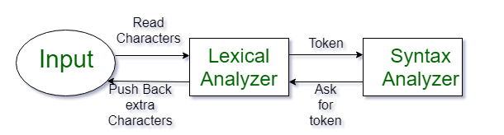
Cont..
What is a Token?
A lexical token is a sequence of characters that can be treated as a unit in the grammar of the programming languages.

Slide 21
Example of tokens
Type token (id, number, real, . . . )
Punctuation tokens (IF, void, return, . . . )
Alphabetic tokens (keywords)
Keywords; Examples - for, while, if etc. Identifier; Examples - Variable name, function name, etc. Operators; Examples '+', '++', '-' etc. Separators; Examples ',' ';' etc

Slide 22
Example of Non-Tokens
Comments, preprocessor directive, macros, blanks, tabs, newline, etc.

Slide 23
What is a Lexeme?
The sequence of characters matched by a pattern to form the corresponding token or a sequence of input characters that comprises a single token is called a lexeme. eg- “float”, “abs_zero_Kelvin”, “=”, “-”, “273”, “;” .

Slide 24
Implementation of Lexical Analyzers and Syntax Analysis Introduction to Lexical Analyzers
- Converts source code into tokens.
- First phase of the compiler.
- Removes white spaces and comments.
- Identifies keywords, identifiers, operators, and literals.
Example:
`int x = 10;` → Tokens: `int`, `x`, `=`, `10`, `;`

Slide 25
Lexical Analyzer Generator (LEX)
- Tool for generating lexical analyzers.
- Input: Regular expressions.
- Output: C code for token recognition.
- Used in conjunction with YACC.
Example:
```
%%
[0-9]+ { printf("NUMBER"); }
[a-zA-Z]+ { printf("IDENTIFIER"); }
%%
```

Slide 26
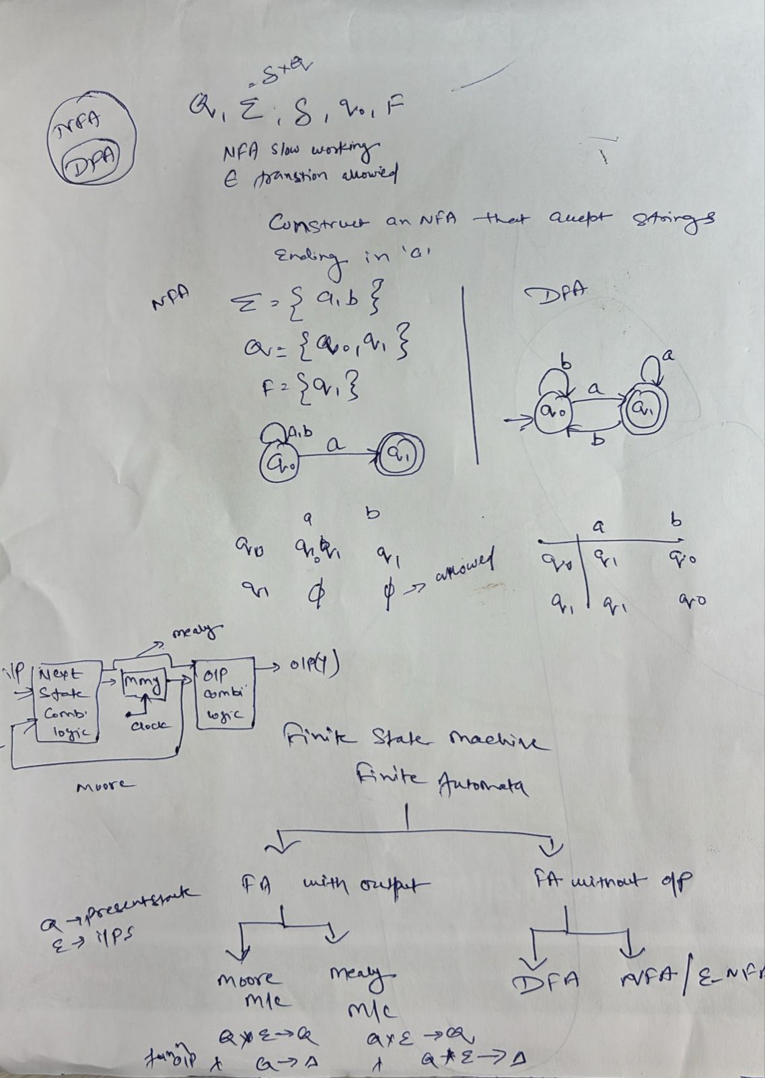
Finite Automata

Slide 27
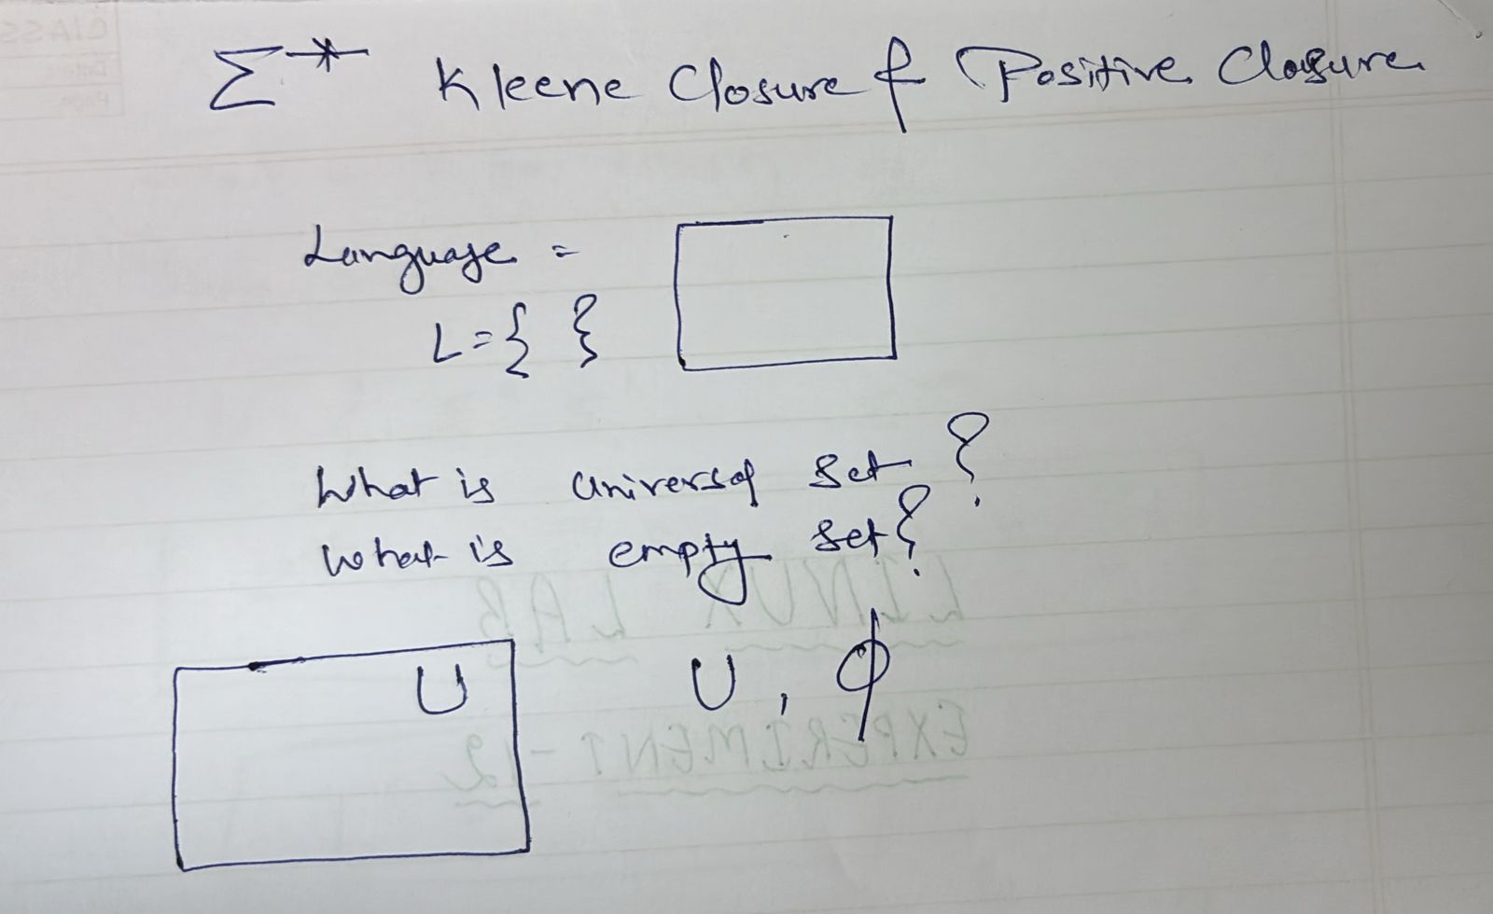
Kleene’s Theorem Or Kleene Closures

Slide 28
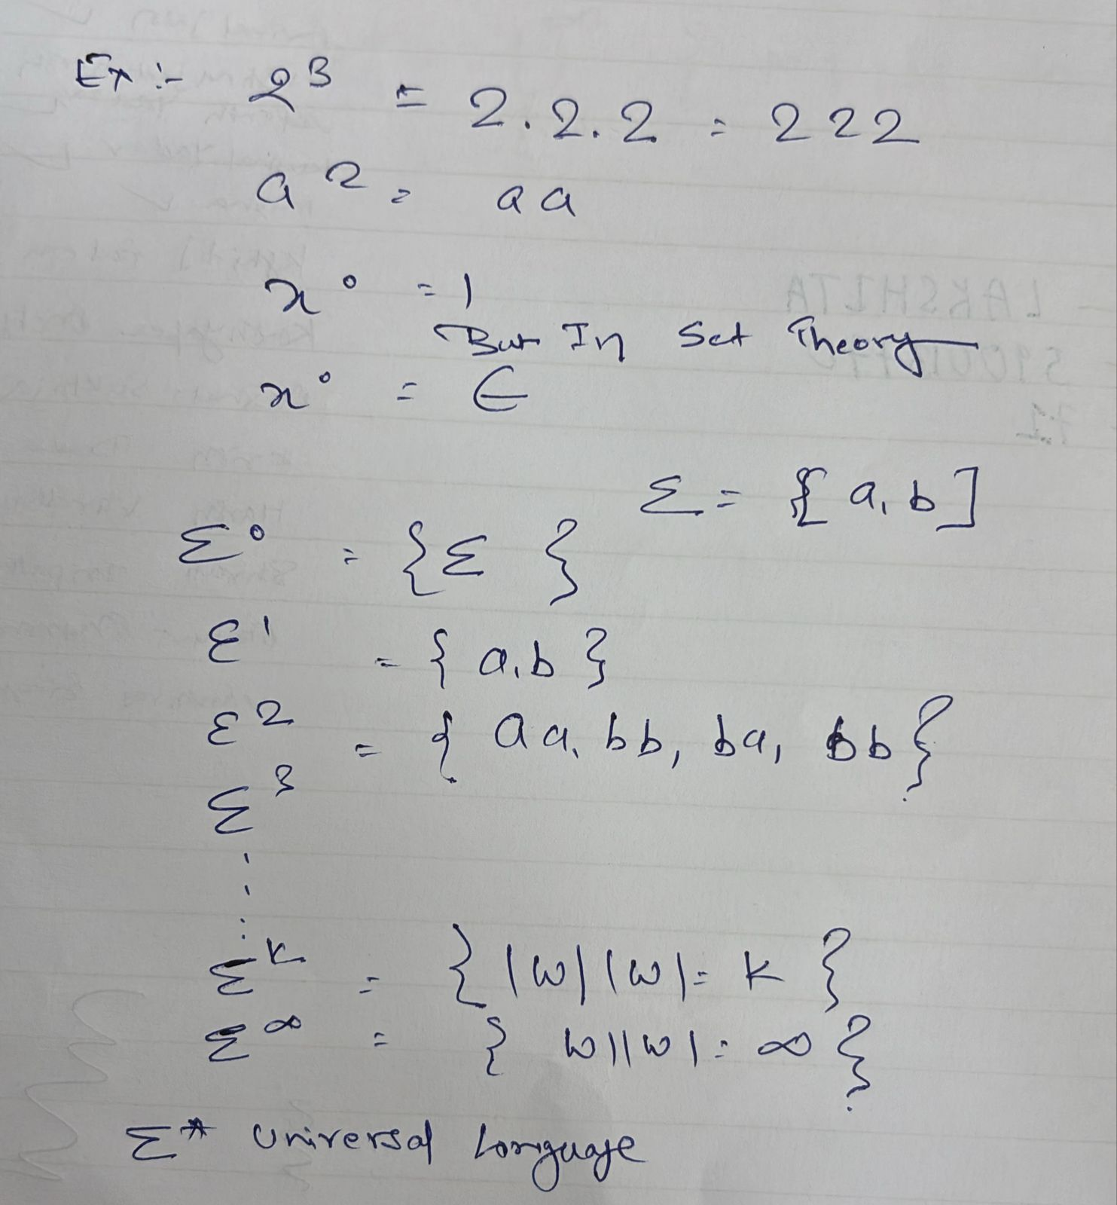
Example

Slide 29
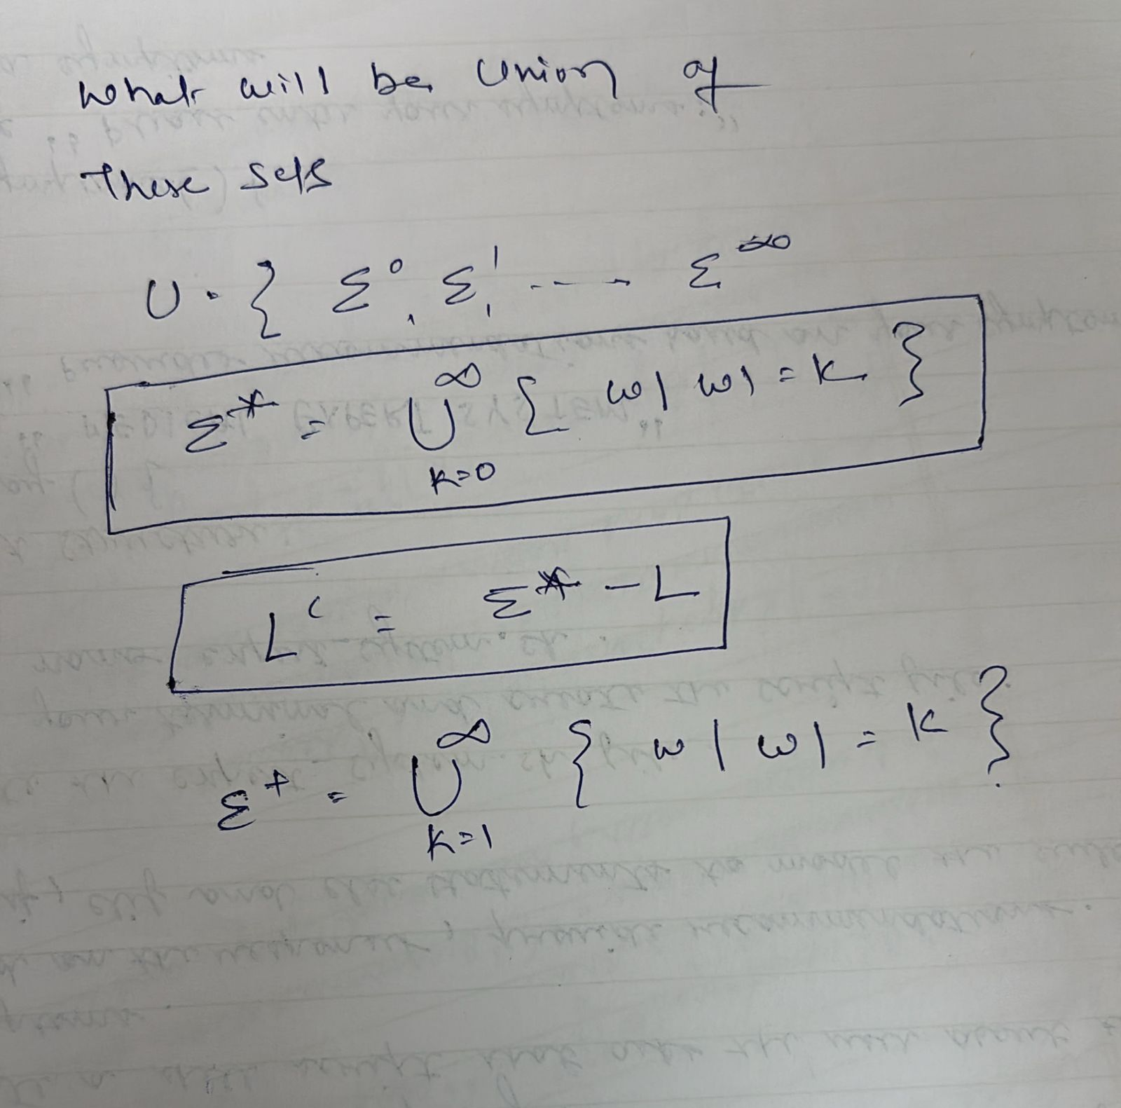
Cont..

Slide 30
Regular expression
(shortened as regex or regexp),referred to as rational expression, is a sequence of characters that specifies a match pattern in text.
Usually such patterns are used by string-searching algorithms for "find" or "find and replace" operations on strings, or for input validation.
Regular expression techniques are developed in theoretical computer science and formal language theory.

Slide 31
Examples:
To match a sequence of literal characters, simply write those characters in the pattern.
To match a single character from a set of possibilities, use square brackets, e.g. [0123456789] matches any digit.
To match zero or more occurrences of the preceding expression, use the star (*) symbol.
To match one or more occurrences of the preceding expression, use the plus (+) symbol.
It is important to note that regex can be complex and difficult to read, so it is recommended to use tools like regex testers to debug and optimize your patterns.

Slide 32
Cont..
Example : Regular expression for an email address : ^([a-zA-Z0-9_\-\.]+)@([a-zA-Z0-9_\-\.]+)\.([a-zA-Z]{2,5})$

Slide 33
Cont..
Example:
Keywords: if, else, while, etc.
Identifiers: [a-zA-Z_][a-zA-Z0-9_]*
Numbers: [0-9]+(\.[0-9]+)?

Slide 34
Operations
The various operations on languages are:
Union of two languages L and M is written as
L U M = {s | s is in L or s is in M}
Concatenation of two languages L and M is written as
LM = {st | s is in L and t is in M}
The Kleene Closure of a language L is written as
L* = Zero or more occurrence of language L.

Slide 35
Mathematical Model of Finite Automata
Finite set of states (Q)
Finite set of input symbols (Σ)
One Start state (q0)
Set of final states (qf)
Transition function (δ)

Slide 36
Token generation
There are 6 types of C tokens :
identifiers, keywords, constants, operators, string literals and other separators.

Slide 37
Find the tokens
Question: printf("HELLO WORLD");
Token are:
printf
(
"HELLO WORLD"
)
;

Slide 38
Cont..
There are total 5 tokens in the above printf statement.

Slide 39
Cont..
. The number of tokens in the given C statement is ______.
printf("pt = %d, &pt = %x", pt, &pt);

Slide 40
Answer
printf
(
"pt = %d, &pt = %x"
,
pt
,
&
pt
)
;

Slide 41
Implementation of Lexical Analyzers,
Components of a Lexical Analyzer
Transition Table (Finite Automata):
Represents the states and transitions based on input characters. It can be deterministic (DFA) or non-deterministic (NFA).
Regular expressions are converted into DFAs during implementation.
Symbol Table:
Stores information about identifiers, such as names, types, and scope.
Lexer Rules:
Each regex pattern corresponds to a rule for identifying tokens.

Slide 42
Example Lex Specification:
%{
#include <stdio.h>
%}
%%
if { printf("KEYWORD: %s\n", yytext); } //yytext: A predefined variable in Lex that stores the matched text.
[a-zA-Z_][a-zA-Z0-9_]* { printf("IDENTIFIER: %s\n", yytext); }
[0-9]+(\.[0-9]+)? { printf("NUMBER: %s\n", yytext); }
[+\-*/=] { printf("OPERATOR: %s\n", yytext); }
[ \t\n] ; // Ignore whitespaces
. { printf("ERROR: %s\n", yytext); }
%%
int main() {
yylex(); \\A function generated by Lex. Reads the input, matches patterns, and executes the corresponding actions.
return 0;
}

Slide 43
Run the code
lex lexer.l
gcc lex.yy.c -o lexer -ll
./lexer < input.txt

Slide 44
How Lexical Analyzer Generators Work
1. Input Specification
The user writes a specification file containing:
Token patterns: Described using regular expressions.
Actions: Code to execute when a pattern is matched (e.g., print the token or store it in a data structure).
2. Code Generation
The generator processes the input specification and creates source code in the target programming language (e.g., C for Lex/Flex).
3. Tokenization
The generated lexical analyzer reads the input source code, matches it against the token patterns, and outputs a stream of tokens.

Slide 45
Features of a Good Lexical Analyzer
Efficiency: Quick tokenization of source code.
Error Handling: Clear and informative error messages.
Extensibility: Easy addition of new tokens or patterns.
Portability: Adaptable to different programming languages and environments.

Slide 46
Formal Grammars and Their Applications to Syntax Analysis
- Define rules for constructing valid sentences in a language.
- Help in syntax validation and parsing.
- Types: Regular Grammar, Context-Free Grammar (CFG).
Example:
`E → E + T | T`

Slide 47
Formal Grammars
What are Formal Grammars?
Formal grammars are mathematical frameworks used to describe the syntax of languages. They define the rules for forming valid strings (sentences) in a language.

Slide 48
Cont..
Type 0 (Unrestricted Grammar):
Most general grammar.
Rules: α→β where α and β are strings of symbols.
Type 1 (Context-Sensitive Grammar):
Rules depend on context.
Form: αAβ→αγβ where γ≠ε
Type 2 (Context-Free Grammar - CFG):
Rules have a single non-terminal on the left-hand side.
Form: A→γ , where A is a non-terminal and γ is a string of terminals and/or non-terminals.
Type 3 (Regular Grammar):
Simplest form, used in LEX.
Rules are either A→aB A→aA where A,B are non-terminals and a is a terminal.

Slide 49
Syntax Analysis in Compiler Design
Syntax analysis ensures that these tokens are arranged according to with the programming language’s grammar.
Its primary goal is to verify the syntactical correctness of the source code. It takes the tokens generated by the lexical analyzer and attempts to build a Parse Tree or Abstract Syntax Tree (AST), representing the program’s structure.

Slide 50
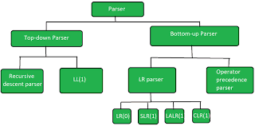
Parsing Algorithms Used in Syntax Analysis

Slide 51
Features of Syntax Analysis
Syntax Trees
Context-Free Grammar
Top-Down and Bottom-Up Parsing
Error Detection
Intermediate Code Generation
Optimization

Slide 52
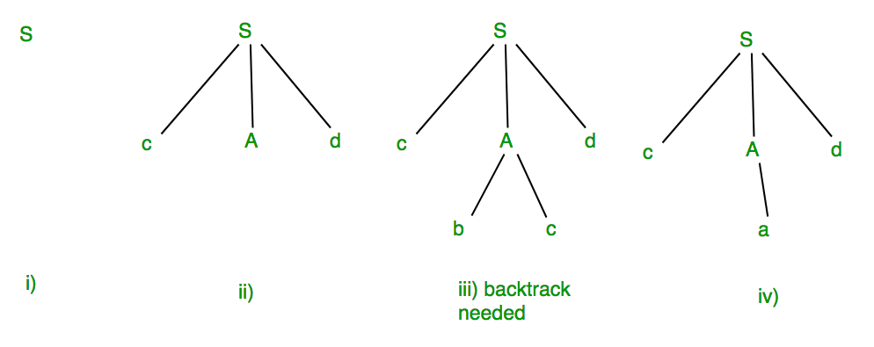
S -> cAd A -> bc|a And the input string is “cad”.

Slide 53
Integration of LEX and Syntax Analysis
LEX is often used with YACC (Yet Another Compiler Compiler) or similar tools to perform lexical and syntax analysis together.
Tokenizes the input source code using regular expressions.
Outputs tokens (e.g., IDENTIFIER, NUMBER, KEYWORD).
YACC:
Uses CFGs to parse the token stream from LEX.
Constructs a parse tree or performs semantic analysis.

Slide 54
Example: LEX for Arithmetic Expressions
%{
#include <stdio.h>
%}
%%
[0-9]+ { printf("NUMBER: %s\n", yytext); }
[+\-*/()] { printf("OPERATOR: %s\n", yytext); }
[ \t\n]+ ; // Ignore whitespace
. { printf("INVALID: %s\n", yytext); }
%%
int main() {
yylex();
return 0;
}

Slide 55
CFG for Arithmetic Expressions
%token NUMBER
%%
expression: term | expression '+' term | expression '-' term ;
term: factor | term '*' factor | term '/' factor ;
factor: NUMBER | '(' expression ')' ;
%%

Slide 56
Question Construct CFG
For the grammar given below, find out the context-free language. The grammar G = ({S}, {a, b}, S, P) with the productions are;
S → abB, (Rule: 1) A → aaBb (Rule: 2) A → ε (Rule: 3) B → bbAa (Rule: 4)

Slide 57
Cont..
Solution:
First compute some strings generated by the production rules of the grammar G in the above;
(i) S ⇒ abB, (Rule: 1) ⇒ ab bbAa (Rule: 4) ⇒ ab bb ε a (Rule: 3) i.e. ⇒ ab bba
(ii) S ⇒ abB, (Rule: 1) ⇒ ab bbAa (Rule: 4) ⇒ ab bb aaBb a (Rule: 2) ⇒ ab bb aa bbAa ba (Rule: 4) ⇒ ab bb aa bb ε a ba (Rule: 3) i.e ⇒ ab bb aa bba ba

Slide 58
Cont..
(iii) S ⇒ abB, (Rule: 1) ⇒ ab bbAa (Rule: 4) ⇒ ab bb aaBb a (Rule: 2) ⇒ ab bb aa bbAa ba (Rule: 4) ⇒ ab bb aa bb aaBb a ba (Rule: 2) ⇒ ab bb aa bb aa bbAa b a ba (Rule: 4) ⇒ ab bb aa bb aa bb ε a b a ba (Rule: 3) i.e ⇒ ab bb aa bb aa bba ba ba
(iv) S ⇒ abB, (Rule: 1) ⇒ ab bbAa (Rule: 4) ⇒ ab bb aaBb a (Rule: 2) ⇒ ab bb aa bbAa ba (Rule: 4) ⇒ ab bb aa bb aaBb a ba (Rule: 2) ⇒ ab bb aa bb aa bbAa b a ba (Rule: 4) ⇒ ab bb aa bb aa bb aaBb a ba ba (Rule: 2) ⇒ ab bb aa bb aa bb aa bbAa ba ba ba (Rule: 4) ⇒ ab bb aa bb aa bb aa bb ε a ba ba ba (Rule: 3) i.e ⇒ ab bb aa bb aa bb aa bba ba ba ba

Slide 59
Cont..
Hence; Language generated by the above grammar L(G) = { ab bba (minimum string) ab bb aa bba ba ab bb aa bb aa bba ba ba ab bb aa bb aa bb aa bba ba ba ba ⋮ ⋮ } By analyzing the above generated string form the grammar G, there has a similar pattern in all computed strings, i.e.
The minimum length of the string consist ab bba always.
After obtained the minimum string there have some repetition of strings comes i.e. the loop of string (bb aa and ba) comes finite times. (Note: Highlighted by underlined strings)
Thus we can write the language of the grammar L(G) = {ab (bb aa)^{n} bba (ba)^{n} : n ≥ 0}

Slide 60
Ambiguous Grammar
Depending on the Number of Derivation trees, CFGs are sub-divided into 2 types:
Ambiguous grammars
Unambiguous grammars

Slide 61
Set of alphabets ? = {0,…,9, +, *, (, )} E -> I E -> E + E E -> E * E E -> (E) I -> ? | 0 | 1 | … | 9
I) First leftmost derivation II) Second leftmost derivation
E=>E*E E=>E+E
=>I*E =>E*E+E
=>3*E+E =>I*E+E
=>3*I+E =>3*E+E
=>3*2+E =>3*I+E
=>3*2+I =>3*2+I
=>3*2+5 =>3*2+5

Slide 62
Question
Check whether the given grammar is ambiguous or not-
S → AB / C
A → aAb / ab
B → cBd / cd
C → aCd / aDd
D → bDc / bc

Slide 63
Consider the same string for the question
w = aabbccdd

Slide 64
Backus-Naur Form (BNF) Notation
- Standard notation to describe the syntax of programming languages.
- Uses production rules.
Example:
<expression> ::= <term> | <term> + <expression>
<term> ::= <factor> | <factor> * <term>

Slide 65
BNF Cont..
::= 'is defined as'
| 'or'
<> category
The way that these symbols are laid out are as such:
<Parent Expression> ::= <Child Expression 1> | <Child Expression 2>

Slide 66
Backus-Naur Form Breakdown of a Home Address
<Address> ::= <House Number> <Street Name> <Town Name> <City Name> <Country> <Postcode> | <House Number> <Street Name> <City Name> <Country> <Post Code>

Slide 67
Cont..
<Postcode> ::= <Area Code> <Street Code>
<Area Code> ::= <City Prefix> <digit> | <City Prefix> <digit> <digit>
<Street Name> ::= <Name> <Street Type>
<Flat Number> ::= <character> | <digit>
<House number>::= <digit> | <digit> <House number>
<Street Type> ::= <string>
<City Prefix> ::= <string>
<Street Code> ::= <string>
<Town Name> ::= <string>
<City Name> ::= <string>
<Country> ::= <string>
<Name>::= <string>

Slide 68
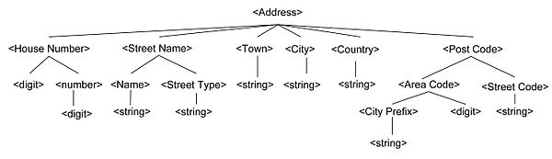
Cont..

Slide 69
BNF Rule for If condition?
Question : BNF for If-else condition.

Slide 70
Cont..
if (<expression>) then <statement> else <statement>
=> if (x > 0) then <statement> else <statement>

Slide 71
Cont..
<if-statement> ::= if (<condition>) then <statement> [else <statement>]
<condition> ::= <expression> | true | false
<statement> ::= <assignment> | <if-statement>
<assignment> ::= <identifier> = <expression>
<expression> ::= <number> | <identifier>

Slide 72
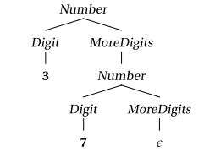
Number ::⇒ Digit MoreDigits MoreDigits ::⇒ MoreDigits ::⇒ Number Digit ::⇒ 0 | 1 | 2 | 3 | 4 | 5 | 6 | 7 | 8 | 9

Slide 73
Ambiguity in Grammars
- A grammar is ambiguous if it produces more than one parse tree for the same string.
Example:
```
E → E + E | E * E | id
```
- Solution: Use precedence and associativity rules.

Slide 74
YACC (Yet Another Compiler Compiler)
It is used to define grammars and create parsers. For this task, the grammar handles arithmetic expressions like 5 + 3 - 2.

Slide 75
%{
#include <stdio.h>
#include <stdlib.h>
// Function to handle errors
void yyerror(const char *s) {
printf("Error: %s\n", s);
}
// Declare the lexer function
int yylex();
%}
%token NUMBER
%%
expression:
expression '+' expression { $$ = $1 + $3; }
| expression '-' expression { $$ = $1 - $3; }
| NUMBER { $$ = $1; }
;
%%

Slide 76
Cont..
int main() {
printf("Enter an arithmetic expression (e.g., 5 + 3 - 2):\n");
if (yyparse() == 0) {
printf("Parsing successful!\n");
} else {
printf("Parsing failed!\n");
}
return 0;
}

Slide 77
YACC (Yet Another Compiler Compiler)
- Parser generator tool.
- Input: Context-Free Grammar.
- Output: C code for syntax analysis.
- Works with LEX.
Example:```
%%
E : E '+' T
| T ;
T : T '*' F
| F ;
F : '(' E ')'
| NUM ;
%%
```

Slide 78
Cont..
/* definitions */
....
%%
/* rules */
....
%%
/* auxiliary routines */
....

Slide 79
Context-Free Grammar (CFG)
- Set of production rules.
- Used to define the syntax of programming languages.
- CFG Components:
- Non-terminals
- Terminals
- Start Symbol
- Production Rules
Example:
```
S → aSb | ε
```

Slide 80
Derivation and Parse Tree
- **Derivation:** Sequence of production rule applications.
- **Parse Tree:** Graphical representation of derivation.
Example Parse Tree:
```
E
/|\
E + T
```

Slide 81
Capabilities of CFG
- Defines recursive syntactic structures.
- Parses arithmetic expressions, conditional statements, loops, etc.
- Basis for modern parsers and compilers.

Slide 82
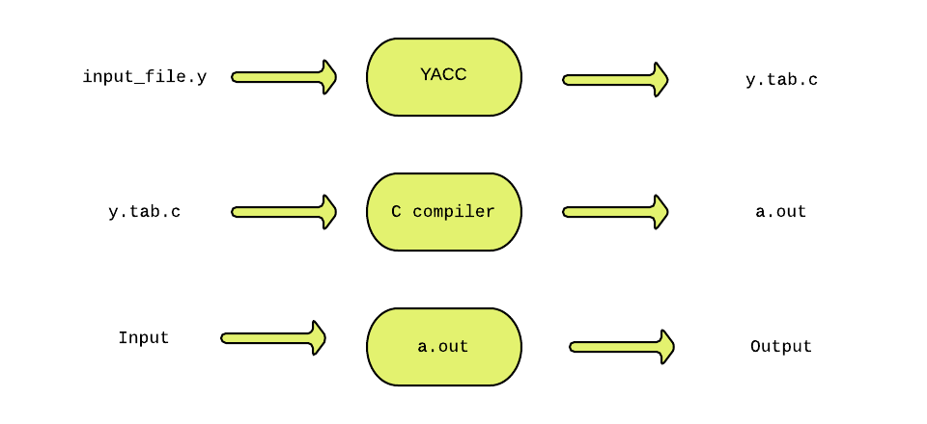
YACC

Slide 83
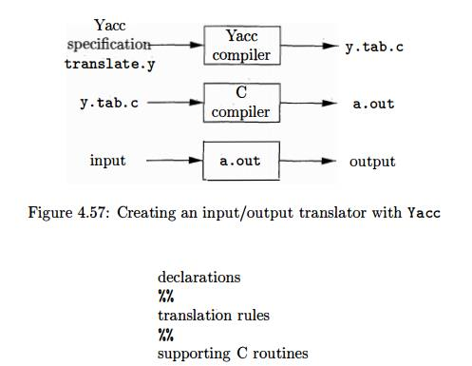

Slide 84
Cont..
YACC stands for Yet Another Compiler Compiler.
YACC provides a tool to produce a parser for a given grammar.
YACC is a program designed to compile a LALR (1) grammar.
It is used to produce the source code of the syntactic analyzer of the language produced by LALR (1) grammar.
The input of YACC is the rule or grammar and the output is a C program.

Slide 85
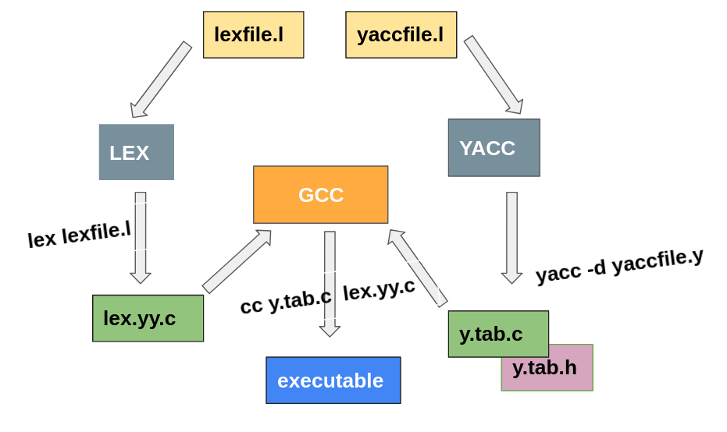
Cont..

Slide 86
Cont..
Input: A CFG- file.y
Output: A parser y.tab.c (yacc)

Slide 87
Conclusion
- Lexical analysis identifies tokens.
- Syntax analysis ensures syntactic correctness using CFG.
- Tools like LEX and YACC automate analysis.

Slide 88
Q&A
Thank You!
Any Questions?

